Slide 1
UECS1013 Introduction to Computer Organisation and Architecture
Lecture 5:
Computer Architecture &
Assembly Language
(ARM Processor)

Slide 2
Complex Instruction Set Computing (CISC)
An architecture with complex instruction set which combines multiple operations within a single instruction. Shifts the burden to the processor (hardware) which has to implement complicated instructions.
Extensive instruction set. E.g. multi-clock complex instructions,
register-memory transfer + ALU operations
memory-to-memory data transfer: Move the content from memory location A to the memory location B
MOVE A, B
“LOAD” and “STORE” incorporated within this single instruction
Most common microprocessors are based on CISC:
Motorola 68000 family
Intel x86 architecture based processors.
System/360(excluding the 'scientific' Model 44), VAX, PDP-11, etc.

Slide 3
Complex Instruction Set Computing (CISC)
Pros:
Simple and smaller codes. Less instructions are needed per-program. This reduces the frequency of accessing the slow main memory.
Smaller codes → consumes less memory → Save money (expensive during those days)
Only requires a simple compiler since the micro program has taken care of the intermediate operations

Slide 4
Complex Instruction Set Computing (CISC)
Cons:
Many instructions are too specialized and infrequently used – only 20% of the instructions are used in a typical program.
Hardware tends to become more complex. Multiple operations lead to many different kinds of instructions that access memory.
The complexity of instructions varies significantly
→ Different instruction length (instruction alignment consideration)
→ Execution time for fetch-decode varies (timing issues)
CISC machines tend to become more complex for newer generations which are typically the superset of the older generations.
Commands needs to be translated into a series of microcode commands for execution → Tends to run slower than an equivalent series of simpler commands in RISC (do not require microcode translation).

Slide 5
Reduced Instruction Set Computing (RISC)
Emerged around early 1980s with IBM 801, Stanford MIPS and UC-Berkeley RISC 1 and 2.
Designers found that existing processor ISAs had extensive instructions that were too complex.
Design philosophy: use the minimum set of instruction set to carry out all essential operations
Once cycle execution time: RISC processors have a CPI of one cycle owing to a simple instruction set
Pipelining: Allows the simultaneous execution of multiple instruction by breaking the instruction into multiple independent stages/parts.
Large number of registers: The savings in complexity for a smaller instruction set translates to a larger number of registers. This helps to minimize the overhead caused by passing parameters on the stack (in the memory) by directing the subroutine to use a subset of registers

Slide 6
Reduced Instruction Set Computing (RISC)
Consistency among instructions is achieved by
Using few simple instructions that are of the same length
Memory access is achieved only through explicit data movement commands such as the load and store instructions
Each instruction performs less work but instruction execution time among different instructions is consistent
The complexity of the operations is moved from ISA to the domain of the assembly programmer/compiler → RISC requires more powerful compiler compared to CISC to translate high-level languages to machine languages
The codes in RISC are longer than CISC but they run faster.
Example RISC Processors:
Apple iPods (custom ARM7TDMI SoC) Apple iPhone (Samsung ARM1176JZF), Palm and PocketPC PDAs and smartphones (Intel XScale family, Samsung SC32442 - ARM9), Nintendo Game Boy Advance (ARM7), Nintendo DS (ARM7, ARM9), Sony Network Walkman (Sony in-house ARM based chip), Some Nokia and Sony Ericsson mobile phones

Slide 7

CISC versus RISC
CISC
Speed up by reducing #instructions per program
Example:
MULT 2:3, 5:2
Emphasis on hardware
Memory-to-memory operations are allowed
Transistors used for implementing a huge set of complex instructions
Multi-clock, non-standardized length instruction
RISC
Speed up by shortening average #cycle/instruction and seconds/cycle
Example:
LOAD A, 2:3, LOAD B, 5:2,
PROD A, B, STORE 2:3, A
Emphasis on software
Register to register where LOAD and STORE are independent instructions
Less transistors for core, resulting in larger register and cache size.
Single-clock and common-length instructions

Slide 8
Hybrid Processors
Recent advances in compiler technology, compiler capability and memory speed and fabrication technology blurs the line between RISC and CISC
Most modern microprocessor is a hybrid.
Modern RISC supports chips as much instructions as yesterday’s CISC chips.
Many CISC chips use many techniques which are previously only limited to RISC such as pipelining.
CISC and RISC systems are becoming more and more alike.

Slide 9
ARM Processor
ARM: “Advanced RISC Machine”
IP Core Provider:
Does not manufacture its own VLSI devices
Sells license to use its core design to electronic companies such as Apple, Samsung, Philips, ATMEL, Sharp, ST and TI.
ARM is one of the most widespread processor cores in the world
In 2007, 98% of new cell phones uses ARM processor and as of 2009, 90% of all embedded 32-bit processors was an ARM. Recently, Cortex-A is used in IPAD.
Why ARM?
Low power, low cost, tiny: Suitable for portable devices
Good performance

Slide 10
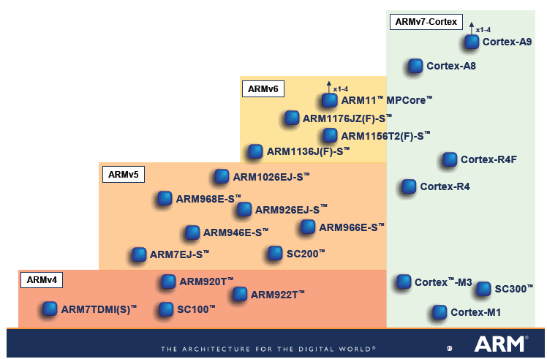
ARM Processor
ARM7 uses von Neuman Architecture (single bus for both data and instruction) while ARM9 and Cortex uses the Harvard Architecture (separate data and instruction bus).
We will be concentrating on ARM 7

Slide 11
ARM Processor
All instructions are 32 bits long.
Most instructions execute in a single cycle.
Every instruction can be conditionally executed.
RISC-based (load/store) architecture
Data processing instructions act only on registers
LDR and STR instructions for memory and register data transfer
Combined ALU and shifter for high speed bit manipulation
Specific memory access instructions with powerful auto-indexing addressing modes.
Flexible multiple register load and store instructions

Slide 12
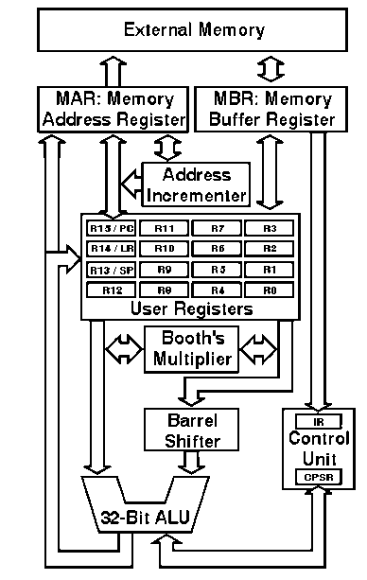
ARM Processor
Interface to bus and external devices
Registers: High-Speed
(local) memory
Arithmetic & Logical Unit
Control
unit

Slide 13
Register Organization
ARM has 37 registers in total, all of which are 32-bits long.
30 general purpose registers
1 dedicated program counter (PC)
1 dedicated current program status register (CPSR)
5 dedicated saved program status registers (SPSR)

Slide 14
Status Registers (CPSR and SPSR)
31
28
8
4
0
N
Z
C
V
I F T
Mode
Copies of the ALU status flags (latched if the
instruction has the "S" bit set).
* Condition Code Flags
* Interrupt Disable bits.
I = 1, disables the IRQ.
F = 1, disables the FIQ.
* T Bit (Architecture v4T only)
T = 0, Processor in ARM state
T = 1, Processor in Thumb state
N = Negative result from ALU flag.
Z = Zero result from ALU flag.
C = ALU operation Carried out
V = ALU operation oVerflowed
* Mode Bits
[4:0] define the processor mode.
Holds information of the most recently executed ALU operation if suffix “S” is attached to the instruction.
Control the enabling and disabling of interrupts.
Set the processor operating mode
Notes:
Similarly in other 4 modes, though here only r13->r14 swapped.
“Banked” registers stored between mode swaps. Useful for interrupt handling because nothing to set up. Can thus run more quickly.

Slide 15
Status Registers (CPSR and SPSR)
31
28
8
4
0
N
Z
C
V
I F T
Mode
N (Negative Flag)
Indicates a negative in the arithmetic operation
Example (Subtract 10 from R2)
SUBS R6, R2, R3 ; R2 = 2, R3 = 10
(CPSR will be updated, N = 1)
SUB R6, R2, R3 ; R2 = 2, R3 = 10
(CPSR will NOT be updated, N is not updated)

Slide 16
Status Registers (CPSR and SPSR)
31
28
8
4
0
N
Z
C
V
I F T
Mode
Z(Zero Flag)
Indicates a zero in the arithmetic operation
Example (Subtract 10 from R2)
SUBS R6, R2, #10 where R2 = 10
C(Carry Flag)
Operations (e.g. addition) results in carry
Example:
ADDS R6, R2, #0xFFFFFFFF where R2 = #0xFFFFFFFF = -1
Does not necessarily cause overflow. For example, addition of negative numbers may generate a carry but no overflow.

Slide 17
Status Registers (CPSR and SPSR)
31
28
8
4
0
N
Z
C
V
I F T
Mode
V (Overflow Flag)
An arithmetic overflow has occurred.
Example: ADDS R6, R2, #0x7FFFFFFF where R2 = #0x7FFFFFFF
Two positive number produces a negative number in 2nd Complement!

Slide 18
Program Counter
PC is used to point to the next instruction to be executed
All instructions are 32 bits in length and therefore all instructions must be word aligned
Therefore the PC value is stored in bits [31:2] with bits [1:0] equal to zero (as instruction cannot be halfword or byte aligned).
Memory
Example: A + B
Currently executed instruction is at address 0x4000
0x4000
LDR R1, A
0x4004
LDR R2, B
0x4008
ADD R1, R1, R2
PC
0x00004004

Slide 19
Operating Modes
Although there are 37 registers in total, a programmer have access to maximum of 17 registers in user mode and 18 in privileged mode
The ARM has six different operating modes:
User: unprivileged mode under which most tasks run
Privileged Modes:
IRQ: raised when an external device raises a normal interrupt request
FIQ: entered when an external device raises a fast-interrupt request to obtain urgent service
Supervisor: entered on reset and when a Software Interrupt instruction (SWI) command is executed by a user program
Abort: used to handle memory access violations
Undef: used to handle undefined instructions

Slide 20
Operating Modes
General registers and Program Counter
User32/System
FIQ32
Supervisor32
Abort32
IRQ32
Undefined32
r0
r0
r0
r0
r0
r0
r1
r1
r1
r1
r1
r1
r2
r2
r2
r2
r2
r2
r3
r3
r3
r3
r3
r3
r4
r4
r4
r4
r4
r4
r5
r5
r5
r5
r5
r5
r6
r6
r6
r6
r6
r6
r7
r7
r7
r7
r7
r7
r8
r8_fiq
r8
r8
r8
r8
r9
r9_fiq
r9
r9
r9
r9
r10
r10_fiq
r10
r10
r10
r10
r11
r11_fiq
r11
r11
r11
r11
r12
r12_fiq
r12
r12
r12
r12
r13 (sp)
r13_fiq
r13_svc
r13_abt
r13_irq
r13_undef
r14 (lr)
r14_fiq
r14_svc
r14_abt
r14_irq
r14_undef
r15 (pc)
r15 (pc)
r15 (pc)
r15 (pc)
r15 (pc)
r15 (pc)
Program Status Registers
cpsr
cpsr
cpsr
cpsr
cpsr
cpsr
spsr_fiq
spsr_sup
spsr_abt
spsr_irq
spsr_undef

Slide 21
Operating Modes
The register files are arranged into several banks. The set of registers which are accessible depends on the mode. Example:
R0 to R6 can be accessed in all modes
An assembly program running in user mode is allowed access to R8 but a program running in FIQ mode do not, but instead have access to a different register, R8_FIQ.
Each mode can access
a particular set of R0-R12 registers.
R15 (the program counter)
CPSR (the current program status register)
a particular r13 (the stack pointer) and r14 (link register)
and privileged modes can also access
a particular SPSR (saved program status register)

Slide 22
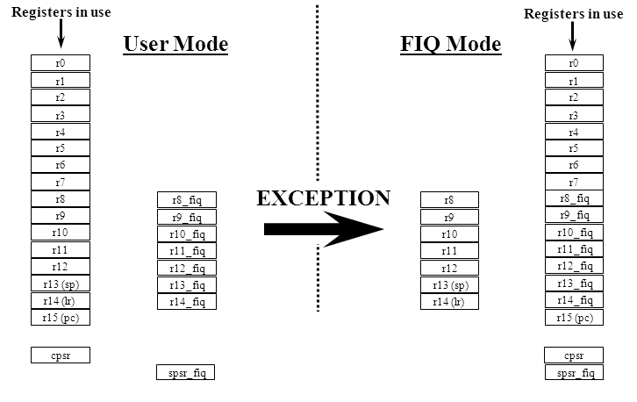
Operating Modes
From User Mode to FIQ Mode
Notes:
Similarly in other 4 modes, though here only r13->r14 swapped.
“Banked” registers stored between mode swaps. Useful for interrupt handling because nothing to set up. Can thus run more quickly.

Slide 23
Assembly Language
Why assembly language?
Many system-level developer will continue to program in assembly language to have more control over the processor.
Writing assembly language programs helps to understand computer architecture.
Many application require the efficiency of assembly language
Learning assembly language helps to know what is happening inside the computer.
The foundation of many abstract concepts in high-level programming languages and operating systems etc. closely related to assembly language and computer architecture.

Slide 24
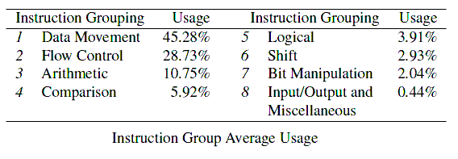
Assembly Language
D.A. Patterson and D.R. Ditzel, “The case for the reduced instruction set computer”, Computer Architecture News, Vol 9(3), 1980.
Common operations of the processors: Data Movement, Flow Control, Logical, Shift, I/O, etc.
Most programs spend over 70% of the time executing instructions from the Data Movement and Flow Control.

Slide 25
Assembly Language
Format of an ARM Instruction
Basic format:
2 variables (destination + source)
3 variables (destination + left source + right source)
Use semi-colon to put comments at the end of statement. All good programs should have high quality comments
Use label to mark current instruction, used in other parts of the program to refer to current instruction
Extended format:
MOV r4, r0 ; a comment r4 ← r0
Label ADD r4, r0, r1 ; a comment r4 ← r0+r1
instruction
destination
source/left
source/right
ADD<cc><s> r4, r0, r1
Conditional execution
CPSR update

Slide 26
Writing your first assembly code
Write the assembly code to perform the following task:
Description:
Write a procedure which adds the content in memory location A and B. Store the result into memory location C.
[C] = [A] + [B]
Input: [A] = 0xA, [B]=0x14
Output: [C]
Notes:
A, B and C are labels which specifies location of the memory (they are just the address in the memory).
[A] are the contents of the memory at the location A.

Slide 27
The Assembly Process
Write source program (.s)
assembler
Machine code
(.o)
Hardware Execution
Debugging
&
verification
Memory map file
(.map)
Simulation
Keil uVision
List file
(.lst)
Write the source program (.s) created using text editor. Using Keil uVision editor to create the source code provides the color code
Assembler
Translates source file to object code (.o)
Recognizes mnemonics for OP codes
Interprets addressing modes for operands
Recognizes directives that define constants and allocate space in memory for data
Labels and names placed in symbol table (.map)

Slide 28
Structure of an Assembly Code
Title of Program
TTL Addition
AREA Program, CODE, READONLY ; start of code
ENTRY
Main
LDR R1, A ; Load content of A into R1
LDR R2, B ; Load content of B into R2
ADD R1, R1, R2 ; ADD and store in R1
STR R1, C ; Store the result
HERE BAL HERE ; end of code
AREA Data1, DATA, READWRITE ; start of data
A DCD 0x0000 000A ; 10
B DCD 0x0000 0014 ; 20
C DCD 0 ; last data
END
Code
Comments
Data
End of Program

Slide 29
Structure of an Assembly Code
Opcodes/Directives
Operands
TTL Addition
AREA Program, CODE, READONLY ; start of code
ENTRY
Main
LDR R1, A ; Load content of A into R1
LDR R2, B ; Load content of B into R2
ADD R1, R1, R2 ; ADD and store in R1
STR R1, C ; Store the result
HERE BAL HERE ; end of code
AREA Data1, DATA, READWRITE ; start of data
A DCD 0x0000 000A ; 10
B DCD 0x0000 0014 ; 20
C DCD 0 ; last data
END
Code Labels
Data
Labels

Slide 30
Skeleton of an assembly program
TTL MyProgram
Put your EQU statements here (e.g., N EQU 12)
AREA MyCode, CODE, READONLY ; start of code
ENTRY
Main
Write your program here (e.g. LDR R0, A)
HERE BAL HERE ; end of code
AREA MyData, DATA, READWRITE ; start of data
Define your data here (e.g., Width DCD 0x12)
; end of data
END

Slide 31
Writing your first assembly code
The corresponding assembly program for the aforementioned problem:
TTL Addition
AREA Program, CODE, READONLY ; start of code
ENTRY
Main
LDR R1, A ; Load content of A into R1
LDR R2, B ; Load content of B into R2
ADD R1, R1, R2 ; Perform A + B
STR R1, C ; Store the result into C
HERE BAL HERE ; end of code
AREA Data1, DATA, READWRITE
A DCD 0x0000000A ; start of data
B DCD 0x00000014
C DCD 0 ; end of data
END

Slide 32
Good Programming Practice
Good Programming Practice
Use instructive names for your variables. Example
x, y, z v.s. width, length, area
Put comments (and good ones) to describe your program
Align your programs using tabs/space
Why is this important?
When your program gets bulky, a good programming practice will make your code more readable and manageable
Allows other engineers/programmer to understand your code easily
You can recall your program easily after you leave it for a period of time
A clean code is easy to debug

Slide 33
Good Programming Practice
A badly written Program
…
LDR R1, A
LDR R2, B
ADD R1, R1, R2
STR R1, C
…
Area Data, DATA, READONLY
B DCD 2
A DCD 0x1
C DCD 0x2

Slide 34
Good Programming Practice
A better program:
TTL Addition
AREA Program, CODE, READONLY ; start of code
ENTRY
Main
LDR R1, A ; Load content of A into R1
LDR R2, B ; Load content of B into R2
ADD R1, R1, R2 ; Perform A + B
STR R1, C ; Store the result into C
HERE BAL HERE ; end of code
AREA Data1, DATA, READWRITE
A DCD 0x0000000A ; input data A
B DCD 0x00000014 ; input data B
C DCD 0 ; output data C
END
A good comment allows us to understand the program
The labels, opcode, operand and comments should be well separated. Use ‘TAB’ to align the columns

Slide 35
Basic ARM Instructions
LDR <Register>,<Label>
Transfer data from memory location (pointed by label) to register
STR <Register>,<Label>
Transfer data from register to memory location (pointed by label)
DCD <val>
Define a word data in data region

Slide 36
Example 1
Write the assembly code to perform the following task:
Description:
Write a procedure which copies the value from memory location in A to B. Store
[B] = [A]
Input: [A]=0x2
Output: [B]
Memory
A
B
0x2

Slide 37
Example 1
CopyOneItem
TTL
AREA , CODE, READONLY
ENTRY
Main
LDR R1, A ; R1 ← [A]
STR R1, B ; [B] ← R1
HERE BAL HERE ; end of code
AREA , DATA, READWRITE
A DCD 0x2 ; input (hexadecimal)
B DCD 0 ; output (initialize to 0)
END
MyFirstProgram
MyData

Slide 38
Basic ARM Instructions
MUL <Rdest>, <Rsource1>,<Rsource2>
Rdest = Rsource 1 x Rsource2
ADD <Rdest>, <Rsource1>, <Rsource2>
Rdest = Rsource 1 + Rsource2
ADD <Rdest>, <Rsource1>, #<Value>
Rdest = Rsource 1 + Value
SUB <Rdest>, <Rsource1>, <Rsource2>
Rdest = Rsource 1 - Rsource2
SUB <Rdest>, <Rsource1>, #<Value>
Rdest = Rsource 1 - Value

Slide 39
Example 2
Write the assembly code to perform the following task:
Description:
Write a procedure which performs the following operation
y = x² + 4
Input: [X] = 10
Output: [Y]
Memory
X
Y
0xA

Slide 40
Example 2
TTL Func1
AREA MyProgram, CODE, READONLY
ENTRY
Main
LDR R1, X ; R1 ← [X]
MUL R2, R1, R1 ; R2 ← X²
ADD R2, R2, #4 ; R2 ← X² + 4
STR R2, Y ; [Y] ← R2 (result)
HERE BAL HERE ; end of code
AREA MyData , DATA, READWRITE
X DCD 10 ; input (decimal)
Y DCD 0 ; output (initialize to 0)
END

Slide 41
Basic ARM Instructions
MOV <Rdest>, #value
Update Rdest with value
MOV <Rdest>,<Rsource>
Transfer data from Rsource to Rdest
LDR <Rdest>, =<Label>
Load Rdest with the memory address that label represents (not the content pointed by label)
LDR <Rdest>, [<Rsource>]
Load Rdest with the memory address that pointed by Rsource
STR <Rsource>, [<Rdest>]
Store Rdest into the memory address pointed by Rdest

Slide 42
Example 3:
Write the assembly code to perform the following task:
Description:
Write a procedure which resets a three-item array in memory location A to 0.
Input: [A]=12, 13, 14
Output: [A] = 0, 0, 0
Memory
A
12
13
14

Slide 43
Example 3
TTL ResetArray
AREA Program, CODE, READONLY
ENTRY
Main
MOV R0, #0
LDR R1, =A ; R1 = A (first item in array A)
STR R0, [R1] ; Set [A] = 0
ADD R1, R1, #4 ; R1 = A + 4 (second item)
STR R0, [R1 ] ; Set [A + 4] = 0
ADD R1, R1, #4 ; R1 = A + 8 (third item)
STR R0, [R1] ; Set [A + 8] = 0
HERE BAL HERE ; end of code
AREA Data1, DATA, READWRITE
A DCD 12, 13,14 ; array A (2 items)
B DCD 0, 0 ; array B (2 items)
END

Slide 44
Example 4
Write the assembly code to perform the following task:
Description:
Write a procedure which copies a two-items array from memory location in A to B.
[B] = [A]
[B+4] = [A+4]
Input: [A]=0x2, [A+4]=0x4
Output: [B], [B+4]
Memory
A
0x2
0x4
B

Slide 45
Example 4
TTL CopyTwoItems
AREA Program, CODE, READONLY ; start of code
ENTRY
Main
LDR R1, =A ; R1 = A (first item in array A)
LDR R2, =B ; R2 = B (first item in array B)
LDR R3, [R1] ; Get [A]
STR R3, [R2] ; [B] ← [A]
ADD R1, R1, #4 ; R1 = A + 4 (second item in array A)
ADD R2, R2, #4 ; R2 = B + 4 (second item in array B)
LDR R3, [R1] ; Get [A+4]
STR R3, [R2] ; [B+4] ← [A+4]
HERE BAL HERE ; end of code
AREA Data1, DATA, READWRITE
A DCD 0x2, 0x4 ; array A (2 items)
B DCD 0, 0 ; array B (2 items)
END

Slide 46
CONDITIONAL OPERATION

Slide 47
Conditional Update of Status Register
instruction<s>
The processor execute the instructions pointed by Program Counter. It will additionally update the CPSR register if the instruction is appended with <s> :
N (negative), Z (zero), C(carry), V(overflow)
Example:
MOVS R0, R1 ; will set the N and Z flags
; depending on the value of R1
MOV R0, R1 ; CPSR will NOT be updated
The CPSR is updated depending on the result of the operation. For example:
ADDS R1, R2, R3
if R2 = -1, R3 = 1, then NZCV = 0110 ; zero and carry set
if R2 = 10, R3 = -20, then NZCV = 1010 ; negative and carry set

Slide 48
Conditional Execution of Instructions
instruction<cc>
Almost all ARM instruction contain a condition field which allows it to be executed conditionally. Add the postfix <cc> to specify condition.
Examples:
ADDS R0, R1, R2 ; R0 ← R1 + R2, update CPSR
MOVEQ R5, R1 ; Conditional execution
R5 is updated only if R0 (from previous addition) is equal to zero. Else the second instruction will not be executed.
MOVSEQ R5, R1 ; Conditional execution + update CPSR.
An instruction will be/will not be executed depending on
The values of CPSR register which are updated by the a previously executed instruction (not necessarily the most recent one)
The type of conditions that are specified by <cc>

Slide 49
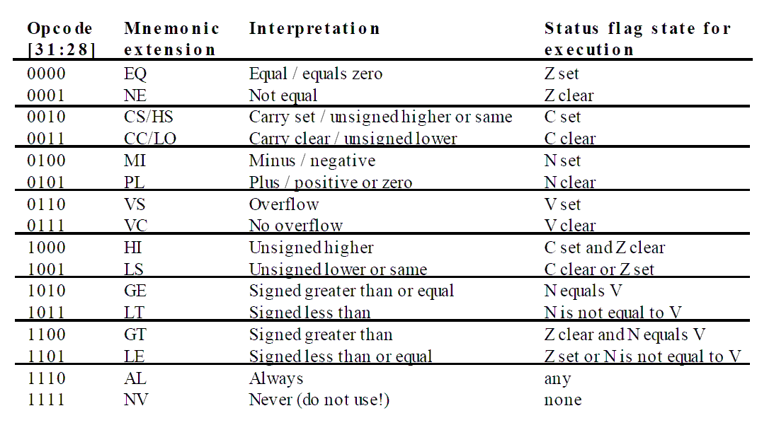
Conditional Execution of Instructions
instruction<cc>
The complete set of conditional flags <cc> that can be used

Slide 50
Conditional Execution of Instructions
instruction<cc>
Greater (GT, GE) and Less (LT, LE) conditions are used for signed number
Higher (HI, HS) and Lower (LO, LS) conditions are used for unsigned number
Can also be used after the comparison (CMP) instruction.
Example 1:
Assume R1 = 0xFFFFFFFF and R2 = 0x00000001
CMP R2, R1 ; Is the signed value of R2 greater than R1?
BGT LOC ; YES (1>-1), branch to LOC
CMP R2, R1 ; Is the unsigned value of R2 greater than R1?
BHI LOC ; NO (1< 4294967295), do not branch
……
Example 2 Example3

Slide 51
SHIFTER OPERAND

Slide 52
Shifter Operand
Instruction <Rd>,<Rs1>,<shifter_operand>
Instruction <Rd>, <shifter_operand>
Name | Shifter_Operand | Example
Immediate | #Value | MOV R0, #2
(2) Register Direct | Rs2 | MOV R0, R1
(3) Register Direct + Barrel Shifter
a) Logical Left-Shift (LSL) | Rs2, LSL <shift> | Add R1, R2, LSL #2
b) Logical Right-Shift (LSR) | Rs2, LSR <shift> | Add R1, R2, LSR #2
c) Arithmetic Right-Shift (ASR) | Rs2, ASR <shift> | Add R1, R2, ASR #2
d) Rotate Right (ROR) | Rs2, ROR <shift> | Add R1, R2, ROR #2
e) Rotate Right Extended (RRX) | Rs2, RRX<shift> | Add R1, R2, RRX #2

Slide 53
Shifter Operand 1: Immediate
Instruction <Rd>,<Rs1>,<shifter_operand>
Instruction <Rd>,<shifter_operand>
Immediate
The simplest addressing mode is to take an immediate value, as the 2nd operand.
All ARM instructions are 32 bits long.
The operand is embedded within the instruction word and occupies 8 bit. This gives a range of 0 to 255 for immediate value.
Example:
MOV R0, #0xC
ADD R0, R1, #4 ; R0 ⬅ R1 + 4
0x0000 000C
R0

Slide 54
Shifter Operand 2: Register Direct
Instruction <Rd>,<Rs1(Opt)>,<shifter_operand>
Register Direct
The Register Direct addressing mode transfers data between registers
Example: Transfers register content from R0 to R1
MOV R1, R0
ADD R1, R2, R3 ; R1 ← R2 + R3
R0
0x0000 4000
R1
xxxx xxxx

Slide 55
Shifter Operand 3: Register Direct + Barrel Shifter
Instruction <Rd>,<Rs1 (Opt)>,<shifter_operand>,<shift>
Register Direct + Barrel Shifter
Operand 2 can also be taken from a register which can be optionally applied with shift operation.
Example: MOV, R0, R1, LSL #4
R0: Operand 1
R1: Operand 2
#4: Shift value
The shift value can be either be:
5 bit unsigned integer: Maximum shift of 32 positions
Specified in the bottom byte of another register.
Operand 1
Operand 2
Barrel Shifter
ALU
Result

Slide 56
Shifter Operand 3: Register Direct + Barrel Shifter
Instruction <Rd>,<Rs1 (Opt)>,<shifter_operand>,<shift>
The shift operation allows the operand to undergo some pre-processing before performing the actual arithmetic
Example:
MOV, R0, R1, LSL #4 ; assume content of R1 = 0x12345678
1. Get the value of R1 (R1 remains untouched)
Original input = 0x12345678
2. Shift the value left by 4 bits
Processed input = 0x23456780
3. Move the final value to R0
R0 = 0x23456780
R1 = 0x12345678

Slide 57
Shifter Operand 3: Register Direct + Barrel Shifter
Instruction <Rd>,<Rs1 (Opt)>,<shifter_operand>,<shift>
Does the using the barrer shifter incurs any additional cost?
When the immediate value of 5-bits field (Range = 0 to 31) is used for barrel shift
MOV R0, R1, ROR #4
No performance overhead incurred
Shift is done for free - executes in single cycle.
When the bottom byte of a register (not PC) is used
MOV R0, R1, ROR R2
Then takes extra cycle to execute
ARM doesn’t have enough read ports to read 3 registers at once.
Then, the performance is reduced to be similar to other processors where shift is separate instruction

Slide 58
Shifter Operand 3: Register Direct + Barrel Shifter
Instruction <Rd>,<Rs1 (Opt)>,<shifter_operand>,<shift>
What is the purpose of having the Barrel Shifter for Operand 2?
It’s free (not incurring any extra cost when properly used)
Shift is a common operation for many programs, e.g. DSP algorithms.
Multiplication instruction is typically much slower than addition in practice
Example: r0 = r1 * 13 Exa ple: r0 = r1 *(1 + 4 + 8)
Example: r0 = r1 + r1*4 + r1*8
Example: r0 = r1 + Shift_Left (r1, 2) + Shift_Left (r1, 3)
ADD r0, r1, r1, LSL #2 ; r0 = r1 + shift(r1, 2)
ADD r0, r0, r1, LSL #3 ; r0 = r0 + shift(r1, 3)

Slide 59
Shifter Operand 3: Register Direct + Barrel Shifter
Instruction <Rd>,<Rs1 (Opt)>,<shifter_operand>,<shift>
The ARM doesn’t have actual shift instructions.
Instead it has a barrel shifter which provides a mechanism to carry out shifts as part of other instructions
There are five types of barrel-shift operations:
left shift (LSL)
logical right-shift (LSR)
arithmetic right-shift (ASR)
Rotate right (ROR)
Rotate right extended (RRX)
LSL, LSR, ASR and ROR are pseudo-instructions (not stand-alone) which are inserted as part of another primary instruction

Slide 60
Shifter Operand 3: Register Direct + Barrel Shifter
Instruction <Rd>,<Rs1 (Opt)>,<shifter_operand>,<shift>
Logical Shift Left (LSL)
Shifts left by the specified amount. The lower bits of the value are appended by 0. Value of shifter_operand remains unchanged
Destination
C
0
Example:
Assume that R1 = 0x0000 0003, R2 = 0x0000 0005
MOV R0, R1, LSL #2 | R0 = 0x0000 000C (3x4 = 12) R1 = 0x0000 0003 (unchanged)
MOV R0, R1, LSL R2 | R0 = 0x0000 0060 (3x32 = 96) R1 = 0x0000 0003 (unchanged)
This is a simple way of performing a multiply by a power of 2 (x2^{n}). For example, LSL #5 = multiply by 32
Notes:
Effectively x 2^{n.}
bits of operand shifted left by specified number of bits.
Zeros are inserted into the right most end of the word
last bit removed from the left most end placed in carry flag.
LSL #0 does nothing and is the default shift if none is specified.

Slide 61
Shifter Operand 3: Register Direct + Barrel Shifter
Instruction <Rd>,<Rs1 (Opt)>,<shifter_operand>,<shift>
Logical Shift Right (LSR)
Shifts left by the specified amount. The lower bits of the value are appended by 0. Value of operand two remains unchanged
Destination
C
0
Example: Assume that R1 = 0x0000 000C, R2 = 0x0000 0003
MOV R0, R1, LSR #2 | R0 = 0x0000 0003 R1 = 0x0000 000C (unchanged)
MOV R0, R1, LSR R2 | R0 = 0x0000 0001 R1 = 0x0000 000C (unchanged)
This is a simple way of performing an unsigned divide by a power of 2 (|÷2^{n}|). For example, LSL #5 = divide by 32
Notes:
Effectively x 2^{n.}
bits of operand shifted left by specified number of bits.
Zeros are inserted into the right most end of the word
last bit removed from the left most end placed in carry flag.
LSL #0 does nothing and is the default shift if none is specified.

Slide 62
Shifter Operand 3: Register Direct + Barrel Shifter
Instruction <Rd>,<Rs1 (Opt)>,<shifter_operand>,<shift>
Arithmetic Shift Right (ASR)
Shifts right (signed divide by powers of 2) by the specified amount & preserves the sign bit for 2's complement operations. E.g. ASR #5 = div by 32
Example:
Arithmetic Shift Right
Destination
CF
Sign bit shifted in
MOV R0, R1, ASR #2 or MOV R0, R1, ASR R2 where R2 = 2 | If R1 = 0x00000010 → R0 = 0x0000 0004 if R1 = 0xFFFF FFF0 → R0 = 0xFFFF FFFC R1 remains unchanged

Slide 63
Shifter Operand (3.4)
Instruction <Rd>,<Rs1 (Opt)>,<shifter_operand>,<shift>
Rotate Right (ROR)
Similar to an ASR but the bits wrap around as they leave the LSB and appear as the MSB. The last bit to be shifted out is also used as the carry out
Example: Assume that R1 = 0x8000 0002, R2 = 0x0000 0003
Rotate Right
Destination
C
MOV R0, R1, LSL #2 | R0 = 0xA000 0000 R1 = 0x8000 0002 (unchanged)
MOV R0, R1, LSL R2 | R0 = 0x5000 0000 R1 = 0x8000 0002(unchanged)
Notes:
Effectively x 2^{n.}
bits of operand shifted left by specified number of bits.
Zeros are inserted into the right most end of the word
last bit removed from the left most end placed in carry flag.
LSL #0 does nothing and is the default shift if none is specified.

Slide 64
Example 1
Write the assembly code to perform the following task:
Description:
Write a procedure which performs the following operation
Y = 20*X1 + X2
Input: M[X1] = 2, M[X2] = 3
Output: M[Y]

Slide 65
But MUL is slow!!!!
TTL func1_slow
AREA MyProgram, CODE, READONLY ; start of code
ENTRY
Main
LDR R0, X1 ; Load content of X1 into R0
LDR R1, X2 ; Load content of X2 into R1
MOV R2, #20 ; R2 = 20 (for multiplication)
MUL R3, R0, R2 ; R3 = 20X1 (Register Direct)
ADD R4, R3, R1 ; R4 = 20X1 + X2 (Immediate)
STR R4, Y ; Save result into Y
HERE BAL HERE ; end of code
AREA Data1, DATA, READWRITE
X1 DCD 2 ; input 1
X2 DCD 3 ; input 2
Y DCD 0 ; output
END

Slide 66
Alternative way:
The instruction “MUL R3, R0, #20” or 20X1 can be converted into a series of shift operations as follows
R3 = R0 * 20
e: r0 = R0 *(4 + 16)
= R0*4 + R0*16
= LSL(R0, 2) + LSL (R0, 4)
Instructions:
MOV R2, #20 →
MUL R3, R0, R2
MOV R3, R0, LSL #2
ADD R3, R3, R0, LSL #4

Slide 67
TTL func1_fast
AREA MyProgram, CODE, READONLY ; start of code
ENTRY
Main
LDR R0, X1 ; Load content of X1 into R0
LDR R1, X2 ; Load content of X2 into R1
MOV R3, R0, LSL #2 ; 4*X1 (Barrel Shift)
ADD R3, R3, R0, LSL #4 ; 4*X1 + 16*X1 ( Barrel Shift)
ADD R3, R3, R1 ; 20X1 + X2 (Register Direct)
STR R3, Y ; Save result into Y
HERE BAL HERE ; end of code
AREA Data1, DATA, READWRITE
X1 DCD 2 ; input 1
X2 DCD 3 ; input 2
Y DCD 0 ; output
END

Slide 68
Example 2
Write the assembly code to perform the following task:
Description:
Write a procedure which performs the second order complement of -X
Y = 2ndComplement (X)
Input: M[X] = 0x00010001
Output: M[Y]

Slide 69
TTL secondcomp
AREA MyProgram, CODE, READONLY ; start of code
ENTRY
Main
LDR R0, X ; Load content of X into R0
MVN R0, R0 ; Invert all bits in R0
ADD R0, R0, #1 ; Add 1 to inverted bits
STR R0, Y ; Store result
HERE BAL HERE ; end of code
AREA Data1, DATA, READWRITE
X DCD 0x0001 0001 ; input
Y DCD 0 ; output
END

Slide 70
ADDRESSING MODES

Slide 71
Addressing Modes
LDR/STR <Rd>,<addressing_mode>
Programs use data structures to organize the information used in computations
One common example is a table containing N integers which are stored in a contiguous memory segment
How to get the fourth integer from the table?
Provide the absolute address → not flexible
Provide the base address of the table + offset → Need only to change the base address if table is loaded elsewhere in the memory
Addressing modes provide different ways to specify the operand locations w.r.t. a base address
***Only applicable to LDR and STR
Base Address
Memory
0x200
5
11
12
2
0x200C
Base Address + 12

Slide 72
Addressing Modes
LDR/STR <Rd>,<addressing_mode>
Name | Syntax | Addressing Function | Example
Register indirect | [Ri] | EA = [Ri] | LDR R0, [R1]
Pre-Indexed Pre-indexed with WriteBack Post-indexed Relative | [Ri, X] [Ri, X]! [Ri], X Label | EA = [Ri] + X; Rk unchanged EA = [Ri]+ X, Rk ← Rk + X EA = [Ri]; Rk ← Rk + X EA = [PC] + offset | LDR R0, [R1, #4] LDR R0, [R1, #4]! LDR R0, [R1], #4 BRA Label
EA = Effective Address
X = index/offset value
Label = a label pointing to the memory location

Slide 73
Register Indirect
LDR/STR <Rd>,<addressing_mode>
Register Indirect
Immediate and Register addressing mode does not handle memory access.
Data transfer between the system memory and a register in the CPU is handled by the LDR and STR instructions only.
The indirect mode is used to access the location of the memory. The location to be accessed is stored in a register where the register plays the role of a pointer.
The Indirect mode provides address in register:
LDR R2, [R5] ; R2 ← M[R5]

Slide 74
Register Indirect
LDR/STR <Rd>,<addressing_mode>
Register Indirect
AREA Code, CODE, READONLY
LDR R0, =Value1
LDR R1, [R0]
…
AREA Table1, DATA, READWRITE
Value 1 DCD 0x11112222
DCD 0x23AB2345
END
Main Memory
Table1
Value1
0x1000
0x1111 2222
0x23AB 2345
0x00001000
R0
1) MOV R0, Value1
0x11112222
R1
2) LDR R1, [R0]

Slide 75
Register Indirect + Indexed
LDR/STR <Rd>,<addressing_mode>
Register Indirect + Indexed
Pre-indexed mode: LDR R0, [R1, Offset]
The effective address of the operand is the sum of the contents of the base register Rn and an offset value
Pre-indexed with writeback mode: LDR R0, [R1, Offset]!
The effective address of the operand is generated in the same way as in the Pre-indexed mode, and then the effective address is written back into Rn
Post-indexed mode: : LDR R0, [R1], Offset
The effective address of the operand is the contents of Rn. The offset is then added to this address and the result is written back into Rn

Slide 76
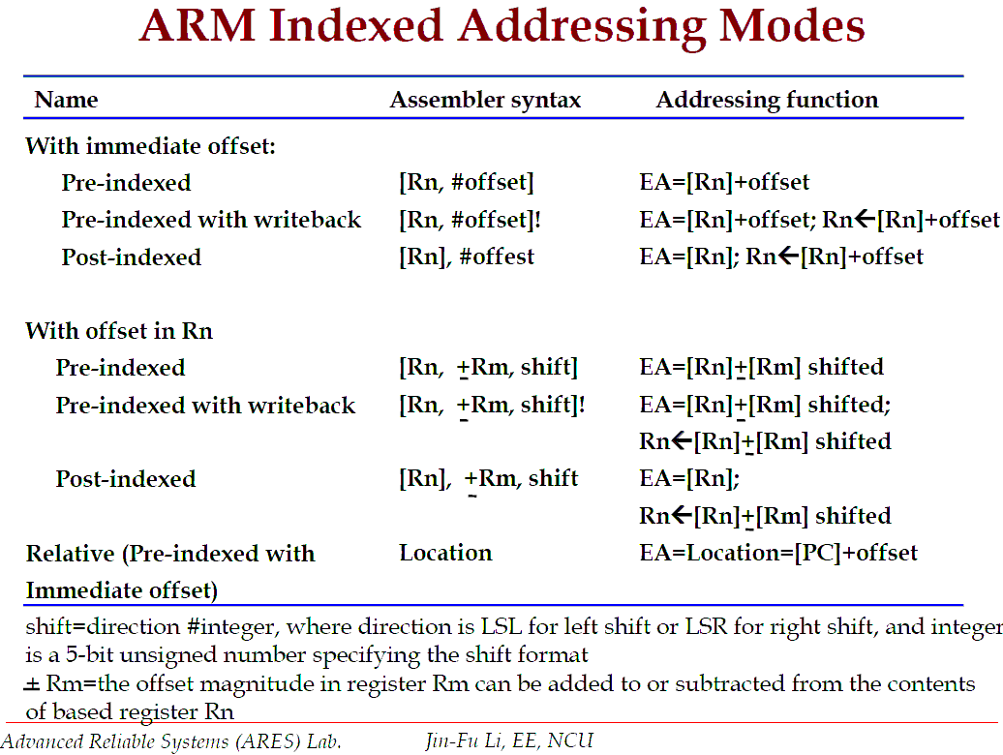
Register Indirect + Indexed
LDR/STR <Rd>,<addressing_mode>

Slide 77
Pre-indexed
LDR/STR <Rd>,<addressing_mode>
Pre-indexed Addressing Mode
Mechanism to provide indexed access to a table. Allows easy access to a particular item in the table. For example, to access the forth item in a table with base register:
STR r0, [r1,#12]
The offset register (R1 in this example) is not changed after instruction execution
This addressing mode avoids hard-coding. When the table is moved to a different location, we simply need to update the base register with the new table starting address
Memory
r0
Source Register for STR
0x5
r1
Base Register
0x200
0x200
Offset
12
0x20c
0x5

Slide 78
Pre-indexed
LDR/STR <Rd>,<addressing_mode>
Pre-indexed Addressing Mode
More examples:
LDR R0, [R1, #4]
LDR R0, [R1, R2]
LDR R0, [R1, R2, LSL#2]
R0 ← M[R1+4].
Registers R1 are not changed
R0 ← M[R1+R2]
Registers R1 and R2 are not changed
R1 ← M[R1 + LSL(R2, 2)]
Registers R1 and R2 are not changed

Slide 79
Pre-indexed with WriteBack
LDR/STR <Rd>,<addressing_mode>
Pre-indexed Addressing Mode with WriteBack
Same as Pre-indexed addressing Mode. The difference is that the offset register will be updated after the operation is completed.
STR r0, [r1,#12]!
The offset register (R1 in this example) is updated after the operation
R1 ← R1 + offset
Useful to implement a loop to perform sequential access to all items in the table
Memory
r0
Source Register for STR
0x5
r1
Base Register
0x200
0x200
Offset
+
12
0x20c
0x5

Slide 80
Pre-indexed with WriteBack
LDR/STR <Rd>,<addressing_mode>
Pre-indexed Addressing Mode with WriteBack
More examples:
LDR R0, [R1, #4]!
LDR R0, [R1, R2]!
LDR R0, [R1, R2, LSL #2]!
R0 ← M[R1+4]
R1 ← R1 + 4
R0 ← M[R1+ R2]
R1 ← R1 + R2
R2 is unchanged
R0 ← M[R1+LSL(R2,2)]
R1 ←R1 + LSL(R2, 2)
R2 is unchanged

Slide 81
Post-Indexed
LDR/STR <Rd>,<addressing_mode>
Post-indexed Addressing Mode
Different from pre-indexed addressing mode, in post-indexed addressing, the effective address is not modified by the offset.
STR r0, [r1] , #12
The offset register is updated only after the operation
R1 ← R1 + offset
Original Base Register
r1
Memory
0x200
r0
Source Register for STR
0x200
0x5
0x5
Updated Base Register
r1
0x20c
12
0x20c
Offset

Slide 82
Post-indexed
LDR/STR <Rd>,<addressing_mode>
Post-indexed Addressing Mode
More examples:
LDR R0, [R1], #4
LDR R0, [R1], R2
LDR R0, [R1], R2, LSL #2
R0 ← M[R1]
R1 ← R1 + 4
R0 ← M[R1]
R1 ← R1 + R2
R2 is unchanged
R0 ← M[R1]
R1 ← R1 + LSL(R2,2)
R2 is unchanged

Slide 83
Example 1
Write the assembly code to perform the following task:
Description:
Write a procedure which adds all items in a table of data (word size).
Input:
M[X] = 0x2, 0x6, 0xA (table)
Output:
M[Y] (sum of items)

Slide 84
TTL AddTable
AREA MyProgram, CODE, READONLY ; start of code
ENTRY
Main
LDR R0, =X ; R0 = X = start of table
LDR R1, [R0], #4 ; R1 = X[0] (post-increment)
LDR R2, [R0], #4 ; R2 = X[1] (post-increment)
LDR R3, [R0] ; R2 = X[2]
ADD R1, R1, R2 ; R1 = X[0] + X[1]
ADD R1, R1, R3 ; R1 = (X[0] + X[1]) + X[2])
STR R1, Y ; save result to Y
HERE BAL HERE ; end of code
AREA Data1, DATA, READWRITE
X DCD 0x2, 0x6, 0xA ; input
Y DCD 0 ; output
END

Slide 85
Example 2
Write the assembly code to perform the following task:
Description:
Write a procedure to copy two consecutive items indexed by IDX and item IDX+1 from array M[X] in a table and saves them into array M[Y]
Input:
M[X] = 0x2, 0x6, 0xA, 0x3, 0x6 (5-item array)
M[IDX] = 2 (third and fourth items)
Output:
M[Y] (2-item array)

Slide 86
TTL CopyTwoIndexedItems
AREA MyProgram, CODE, READONLY ; start of code
ENTRY
Main
LDR R0, =X ; R0 = X = base addr of source table
LDR R1, =Y ; R1 = Y = base addr of target table
LDR R2, IDX ; R2 = IDX = 2
LDR R3, [R0, R2, LSL #2]! ; R0 = base + 4*index, or
; R0 = R0 + 4*R2
; R2 = M[R2] = third item in X = 0xA
LDR R3, [R0, #4]! ; R3 = M[R0+4] = fourth item in X = 0x3
STR R2, [R1], #4 ; Y[0] = R2, R1 = R1 + 4
STR R3, [R1] ; Y[1] = R3
HERE BAL HERE ; end of code
AREA Data1, DATA, READWRITE
IDX DCD 2 ; input index
X DCD 0x2, 0x6, 0xA, 0x3, 0x6 ; input array
Y DCD 0, 0 ; output array
END

Slide 87
ASSEMBLY DIRECTIVE GROUP
EQU, AREA, DCB, DCW, DCD, ALIGN, ENTRY, END

Slide 88
Assembler Directives
An assembler directive tells the assembler something it needs to know in order to carry out the assembly process.
Similar to Preprocessor directives in C-Programming.
Common assembler directives:-
<label> EQU <value> Equate (label is equated with value)
AREA <value> Define an area in the program (code/data)
<label> DCB <value> Define constant (byte)
<label> DCW <value> Define constant (half-word)
<label> DCD <value> Define constant (word)
ALIGN Ensure the next data is aligned to word boundary
ENTRY Specify the entry to the whole program
END End of program

Slide 89
<label> EQU <expr>
EQU equates a symbolic name to a numeric value.
Example
TTL PROG1
Length EQU 16 ; decimal number
Width1 EQU 0x10 ; 0x: hexadecimal number
Width2 EQU 2_10000 ; 2_: binary number
Width2 EQU 8_20 ; 8_: octal number
AREA Program, CODE, READONLY
…
MOV R1, #Length ; equivalent to LDR R1, #16
MOV R2, #Width ; EQU simply replaces the label
Advantages:
The code does not have to be modified even if the values of Length and Width are changed.

Slide 90
AREA <name>, <atr> <atr>, ENTRY, END
AREA establishes indivisible memory regions that are manipulated by the linker. Key attributes include
CODE: area includes only instruction
DATA: area includes only data
READONLY: default for CODE areas
READWRITE: default for DATA areas
ENTRY indicates the point in the code where program execution should begin. There should be only ONE entry point per complete program.
END tells the assembler that the end of a program is reached.
AREA Prog1, CODE, READONLY ; define a new code region labeled as Prog1
ENTRY ; Entry point for program
… ; code write your code here
AREA Table1, DATA , READWRITE ; define a new data region labeled as Table1
… ; data goes here
END ; End of program

Slide 91
<label> DCD <expr>
DCD allocates words (32 bit) of memory, padding as necessary to ensure word alignment and initializes them to the values given
DCD allows you to put a data value in memory at the time that the program is first loaded.
A DCD 0x00BB 00AA
B DCD 0x00CC 00CC
C DCD 0x12, 0x13, 0x14
4000
00BB
00AA
4004
00CC
00DD
4008
0000
0012
400C
0000
0013
4010
0000
0014
4010
400C
A, B and C is actually pointers (point to a memory address). The actual value of A = 0x4000 and B = 0x4004. The content pointed by A or M[A] is 0x00BB 00AA

Slide 92
<label> DCW/DCB <expr>, ALIGN
DCW allocates half-words (16 bit) of memory and initializes it with the value
DCB allocates byte (8 bytes) of memory
ALIGN e-aligns the data so that the next data will be aligned to the word boundary
A DCW 0xBBBB
B DCB 0xAA
ALIGN
C DCB “ABC”
ALIGN
D DCD 0xCCCCCCCC
4000
BBBB
AA
00
4004
4142
43
00
4008
CCCC
CCCC
400C
4010
4010
400C

Slide 93
DATA TRANSFER GROUP
Register to Register (MOV, MVN)
Memory to Register (LDR, LDM)
Register to Memory (STR, STM)

Slide 94
MOV<cond><s> <Rd>,<Shifter Operand>
Performs a move to a register (Rd) the content from another register (with barrel shift) or an immediate value (32 bit)
Flags updated if S used and Rd is not R15: N, Z and C
Example:
MOV R1, R0, LSL #2 ;R1 <- R0*4
Status flags not updated
MOVS R1, #0 ;R1<- 0x00000001
Status flags – N:0, Z:1, V:0, C:0
MOVSNE R0, #0x4
if status flag N = 0, the R0 ← 0x00000004
If status flag N = 1, instruction is ignored

Slide 95
MVN<cond><s> <Rd>,<Shifter Operand>
MVN complements the value of a register or an immediate value and stores it in the destination register (Rd)
Flags updated if S used and Rd is not R15: N, Z and C
Example:
MVN R1, R0, LSL #2 ;R1 <- NOT(R0*4)
Status flag is not updated
MVNS R1, #1 ;R1<- FFFFFFFE
Status flags – N:1, Z:0, V:0, C:0

Slide 96
LDR<cond> <Rd>,<addressing_mode>
Load operand from memory (Index Mode) into target register (Rd)
LDR: Load 32 bits
LDRH: Load halfword (16 bit unsigned #) & zero-extend to 32 bit
LDRSH: Load halfword (16 bit unsigned #) & sign-extend to 32 bit
LDRB: Load byte (8 bit unsigned #) & zero-extend to 32 bit
LDRBH: Load byte (9 bit unsigned #) & sign-extend to 32 bit
No <S> field: status register will not be updated by LDR instruction

Slide 97
Example of LDR indexed addressing modes:
indirect: LDR r0, [r1] ;r0 ← M[r1]
Preindexed LDR r0, [r1, -r2] ;r0 ← M[r1-r2]
Preindexed+WB LDR r0, [r1, #4]! ;r0 ← M[r1+4], r1 ←r1+4
Post-indexed LDR r0, [r1], #4 ;r0 ← M[r1], r1 ← r1 + 4
Example:
LDRS r0, [R1] ;if M[R1]=0 N=0, Z=1, C=0, V=0
LDRSCC r0, [r1] ;conditional execution if carry is clear
;update SR

Slide 98
LDR<cond> <Rd>,<label> LDR<cond> <Rd>,=<label>
When loading a variable defined by a symbol (assuming the data area starts at 0x1000):
LDR R0, =A ; R0 = 0x1000
LDR R1, [R0] ; R1 = M[A] = 0x2
…
LDR R1, A ; R1 = M[A] = 0x2
AREA Table1, DATA, CODE
A DCD 0x2
END

Slide 99
STR<cond> <Rs>,<addressing_mode>
Load operand from source register (Rs) into memory (R, Index)
STR: Store 32 bits
STRH : Store halfword (right-most 16 bit)
STRB: Load halfword (rightmost 8 bit)
No <s> field: status register is not affected by STR
Example:
STR R0, [R1], -R2, LSL#2 ; M[R1] = R0, R1 = R1 – (R2*4)
STR R0, [R1, #4] ; M[R1+4] = R0, R1 unchanged

Slide 100
STR<cond> <Rd>,<label>
When loading a variable defined by a symbol (assuming the data area starts at 0x1000):
MOV R0, #12 ; R0 = 12
STR R0, Result ; M[Result] = 12
AREA Data, DATA, CODE
Result DCD 0
END

Slide 101
LDM<cond> Rs<!>, <list of Rd>
Perform a block transfer of multiple words from the memory into several target registers
LDMIA – increment address by 4 after each load
LDMDA – decrement address by 4 before each load
LDMIB – increment address by 4 before each load
LDMDB – decrement address by 4 before each transfer
No <S> field: status register is not affected by LDM
<!> specifies if Rs is updated after operation (updated if ! Is present)
Addressing Mode | Description | Start Address | End Address | Rs!
IA | Increment after | Rs | Rs + 4*|Rd|- 4 | Rs+4*|Rd|
IB | Increment Before | Rs + 4 | Rs + 4*|Rd| | Rs+4*|Rd|
DA | Decrement After | Rs – (4*|Rd|+4) | Rs | Rs-4*|Rd|
DB | Decrement Before | Rs – (4*|Rd|) | Rs – 4 | Rs-4*|Rd|

Slide 102
Examples:
LDMIA R7, {R0, R2-R4} ; R0 = M[R7]
; R2 = M[R7+4]
; R3 = M[R7+8]
; R4 = M[R7+12]
; R7 is unchanged
LDMDB R7!, {R0, R2-R4} ; R0 = M[R7-16]
; R2 = M[R7 - 12]
; R3 = M[R7 - 8]
; R4 = M[R7 - 4]
; R7 = R7 - 16

Slide 103
Examples:
LDMIA R7, {R0, R2-R4} ; R0 = M[R7]
; R2 = M[R7+4]
; R3 = M[R7+8]
; R4 = M[R7+12]
; R7 is unchanged
LDMDB R7!, {R0, R2-R4} ; R0 = M[R7-16]
; R2 = M[R7 - 12]
; R3 = M[R7 - 8]
; R4 = M[R7 - 4]
; R7 = R7 - 16

Slide 104
STM<cond><Rd><!>, <list of Rs>
Perform a block transfer of multiple words from several source registers into memory
STMIA – increment address after transfer
STMMDA – decrement address after transfer
STMMIB – increment address before transfer
STMDA – decrement address before transfer
No <S> field: status register is not affected by LDM

Slide 105
Examples:
STMIA R7, {R0, R2-R4} ;memory[R7] ← R0
;memory[R7+4] ← R2
;memory[R7+8] ← R3
;memory[R7+12] ← R4
;R7 is unchanged
STMDB R7!, {R0, R2-R4} ;memory[R7-16] ← R0
;memory[R7-12] ← R2
;memory[R7-8] ← R3
;memory[R7-4] ← R4
;R7 ← R7 - 16

Slide 106
Example 1
Write the assembly code to perform the following task:
Description:
Write a procedure to copy an array of five items (word size) from memory location to another array at memory location Y
Input:
M[X] = 0x2, 0x6, 0xA, 0x3, 0x6 (5-item array)
Output:
M[Y] (5-item array)

Slide 107
Example 1
TTL CopyArrays
AREA MyProgram, CODE, READONLY ; start of code
ENTRY
Main
LDR R0, =X ; R0 = X = source table base
LDR R1, =Y ; R1 = Y = target table base
LDMIA R0, {R2-R6} ; Copy X to R2toR6
STMIA R1, {R2-R6} ; Copy R2toR6 to Y
HERE BAL HERE ; end of code
AREA Data1, DATA, READWRITE
X DCD 0x2, 0x6, 0xA, 0x3, 0x6 ; input array
Y DCD 0, 0, 0, 0, 0 ; output array
END

Slide 108
Example 2
Write the assembly code to perform the following task:
Description:
Write a procedure to swap the first two contents of an array with the last two items of the array A
Input:
M[A] = 0x2, 0x6, 0xA, 0x3 (4-item array)
Output:
M[A] = 0xA, 0x3, 0x2, 0x6

Slide 109
Example 2
TTL SwapItems
AREA MyProgram, CODE, READONLY ; start of code
ENTRY
Main
LDR R0, =A ; R0 = A
LDMIA R0, {R2-R5} ; Copy A to R2toR5
STMIA R0!, {R4-R5} ; Copy R4toR5 to top half of A
STMIA R0!, {R2-R3} ; Copy R2toR3 to bottom half of A
HERE BAL HERE ; end of code
AREA Data1, DATA, READWRITE
A DCD 0x2, 0x6, 0xA, 0x3 ; array
END

Slide 110
Example 3
Write the assembly code to perform the following task:
Description:
Write a procedure to swap the array A with array B. Both array contains 12 items
Input:
M[A] = 0x1, 0x2, 0x3, 0x4, 0x5, 0x6, 0x7, 0x8, 0x9, 0x0, 0x1, 0x2
M[B] = 0x11, 0x12, 0x13, 0x14, 0x15,0x16, 0x17, 0x18, 0x19, 0x10,
0x11, 0x12
Output:
M[A] is swapped with M[B]

Slide 111
Example 3
TTL SwapArray
AREA MyProgram, CODE, READONLY ; start of code
ENTRY
Main
LDR R0, =X ; R0 = X = source table base
LDR R1, =Y ; R1 = Y = target table base
LDMIA R0, {R2-R7} ; Copy X[0:5] to R2-R7
LDMIA R1, {R8-R13} ; Copy Y[0:5] to R8-R13
STMIA R1!,{R2-R7} ; Copy R2-R7 (storing X[0:5]) to Y[0:5], Point to Y[6]
STMIA R0!,{R8-R13} ; Copy R8-R13 (storing Y[0:5]) to X[0:5], Point to X[6]
LDMIA R0, {R2-R7} ; Copy X[6:11] to R2-R7
LDMIA R1, {R8-R13} ; Copy Y[6:11] to R8-R13
STMIA R1!,{R2-R7} ; Copy R2-R7 (storing X[6:11]) to Y[6:11], Point to Y[12]
STMIA R0!,{R8-R13} ; Copy R8-R13 (storing Y[6:11]) to X[6:11], Point to X[12]
HERE BAL HERE ; end of code
AREA Data1, DATA, READWRITE
X DCD 0x1, 0x2, 0x3, 0x4, 0x5, 0x6, 0x7, 0x8, 0x9, 0x0, 0x1, 0x2
Y DCD 0x11, 0x12, 0x13, 0x14, 0x15, 0x16, 0x17, 0x18, 0x19, 0x10, 0x11, 0x12
END

Slide 112
ARITHMETIC GROUP
Operations are:
ADD operand1 + operand2
ADC operand1 + operand2 + carry
SUB operand1 - operand2
SBC operand1 - operand2 + carry -1
MUL operand1 * operand2

Slide 113
ADD<cond><s> <Rd>,<Rs1>,<Shift Operand>
Rd ← Rs1 + Shifter Operand
Flags updated if S is used: N, Z, V, C
Examples:
ADDS R4, R2, R0 ; R4← R2 + R0 & update CPSR
ADD R5, R3, R1 ; R5 ← R3 + R1
ADD R5, R3, R1, LSL #2 ; R5← R3 + Logical_Shift_Left ; of R1 by 2

Slide 114
ADC<cond><s> <Rd>,<Rs1>,<Shift Operand>
Addition with carry: Rd ← Rs1 + Shifter Operand + C
The value of C is determined by previous instructions
Flags updated if S is used: N, Z, V, C
The ADC instruction is used to implement efficient multiword addition. For example, if 64-bit numbers are stored in R1:R0 and R3:R2, their sum can be stored in R5:R4 as shown below.
ADDS R4, R2, R0 ; add the least significant word ; field <S> will update the carry bit
ADC R5, R3, R1 ; add the most significant word

Slide 115
SUB<cond><s> <Rd>,<Rs1>,<Shift Operand>
Rd ← Rs1 - Shifter Operand
Flags updated if S is used: N, Z, V, C
Examples:
SUBS R0, R0, #1 ; decrement R0 by 1, update flags
SUB R0, R2, R1 ; R0 ← R2 – R1
SUB R0, R2, R1, LSR #2 ; R0 ← R2 – Logical_shift_right
; of R1 by 2

Slide 116
SBC<cond><s> <Rd>,<Rs1>,<Shift Operand>
Subtract with carry: Rd ← Rs1 - Shifter Operand – NOT C
The value of C is determined by previous instructions.
For subtraction, ARM clears the carry if the result is less than 0 (borrow required). The carry flag (C) is the inverse of a borrow flag. Therefore, if a borrow is required by the operation, C will be set to 0 and SBC will subtract an additional one from current value.
Flags updated if S is used: N, Z, V, C
The SUB instruction is used to implement efficient multiword subtraction. For example, if 64-bit numbers are stored in R1:R0 and R3:R2, their difference can be stored in R5:R4 as shown below.
SUBS R4, R2, R0 ; subtract least significant words
SBC R5, R3, R1 ; subtract most significant words minus borrow

Slide 117
MUL<cond><s> <Rd>,<Rs1>,<Shift Operand>
Rd ← Rs1 * Shift_Operand
Flags updated if S is used: N, Z
MUL performs a 32x32 operation, and stores the lower 32 bit of the result into Rd.
Since only the least significant 32-bits are stored, the result may not be the complete → Suitable only for half-word. To overcome this instruction, use the UMULL instruction.
Example:
MUL R0, R1, R2 ;R0 ← R1*R2

Slide 118
LOGICAL OPERATION
AND operand1 AND operand2
EOR operand1 EOR operand2
ORR operand1 OR operand2
BIC operand1 AND NOT operand2

Slide 119
AND, EOR, ORR, BIC <cond><s> <Rd>,<Rs1>,<Shift Operand>
Syntax:
<Operation>{<cond>}{S} Rd, Rn, Shift_Operand
Flags updated if S used: N, Z, C
Logical operations can be used to manipulate the data. Examples:
AND R0, R0, #0x8000 ; mask bit D15 of R0
EOR R0, R0, #0x8000 ; toggle bit D15 of R0
ORR R0, R0, #0x8000 ; set bit D15 of R0
BIC R0, R0, #0x8000 ; clears bit D15of R0

Slide 120
Example 1
Write the assembly code to perform the following task:
Description:
Write a procedure to add three numbers in memory location Table. Store the result in memory location Result.
Input:
M[Table] = 0x1, 0x3, 0x4 (3-item array)
Output:
M[Result]

Slide 121
TTL Add3No
AREA MyProgram, CODE, READONLY ; start of code
ENTRY
Main
LDR R0, =Table ; Initialize R0 to start of table
LDMIA R0, {R1-R3} ; Get three numbers
ADD R4, R1, R2 ; Add the first and second number
ADD R4, R4, R3 ; Add the third number
STR R4, Result ; Store result
HERE BAL HERE ; end of code
AREA Data1, DATA, READWRITE
Table DCD 0x1, 0x3, 0x4 ; array
Result DCD 0 ; result
END

Slide 122
Example 2
Write the assembly code to perform the following task:
Description:
Write a procedure to add two long words in memory location A and B, respectively. Store the result in memory location Result.
Input:
M[A] = 0x20002000F000F000 (3-item array)
M[B] = 0x3000300010001000
Output:
M[Result]

Slide 123
TTL AddLongNumbers
AREA MyProgram, CODE, READONLY ; start of code
ENTRY
Main
LDR R0, =A ; Initialize R0 to MSB of A
LDMIA R0, {R1-R2} ; MSW → R1, LSW →R2
LDR R0, =B ; Initialize R0 to MSB of B
LDMIA R0, {R3-R4} ; MSW → R3, LSW → R4
ADDS R6, R2, R4 ; Add the LSW (Update CPSR)
ADC R5, R1, R3 ; Add the MSB and carry from LSW
LDR R0, =Result ; Initialize R0 to MSB of Result
STMIA R0, {R5-R6} ; Store long word result to Result
HERE BAL HERE ; end of code
AREA Data1, DATA, READWRITE
A DCD 0x20002000, 0xF000F000
B DCD 0x30003000, 0x10001000
Result DCD 0, 0 ; result
END

Slide 124
Example 3
Write the assembly code to perform the following task:
Description:
Given a five bit binary code stored in the lowest four bits of M[A], convert the binary code into a gray code
Input:
M[A] = 0x0000000B (Binary Code)
Output:
M[B] = 0x0000000E (Gray Code)

Slide 125
TTL ConvertToGrayCode
AREA MyProgram, CODE, READONLY ; start of code
ENTRY
Main
LDR R0, A ; Initialize R0 = M[A] = 1011₂
AND R2, R0, #2_1000 ; R2 = get bit 3 → R2 stores bit 3
AND R3, R0, #2_0100 ; R3 = get bit 2
AND R4, R0, #2_0010 ; R4 = get bit 1
AND R5, R0, #2_0001 ; R5 = get bit 0
EOR R6, R3, R2, LSR #1 ; R6 = bit 2 XOR bit 3 →R6 stores bit 2
EOR R7, R4, R3, LSR #1 ; R7 = bit 1 XOR bit 2 → R7 stores bit 1
EOR R8, R5, R4, LSR #1 ; R8 = bit 0 XOR bit 1 → R8 stores bit 0
ORR R2, R2, R6 ; Accumulate all bits
ORR R2, R2, R7
ORR R2, R2, R8
STR R2, B
HERE BAL HERE ; end of code
AREA Data1, DATA, READWRITE
A DCD 0x0000000B
B DCD 0
END

Slide 126
COMPARISON GROUP
CMP TST TEQ

Slide 127
Comparison Group
The only effect of the comparisons is to
UPDATE THE CONDITION FLAGS. Thus no need to set S bit.
Operations are:
CMP operand1 - operand2, but result not written
TST operand1 AND operand2, but result not written
TEQ operand1 EOR operand2, but result not written
Syntax:
<Operation>{<cond>} Rn, Operand2
Examples:
CMP r0, r1
TSTEQ r2, #5

Slide 128
CMP<cond> <Rn>,<shifter operand>
The CMP instruction performs a subtraction, but does not store the result. The flags are always updated.
Rn – Shifter_operand
Examples:
CMP R0, #1 ; Z=1 if R0 = 1, Z = 0 if R0 > 1
CMP R0, R1 ; Z =1 if R0 = R1, Z = 0 if R0 > R1

Slide 129
TST <cond> <Rn>,<shifter_operand>
The TST instruction performs a non-destructive AND (the result is not stored). The flags are always updated.
The most common use for this instruction is to determine the value of an individual bit of a register.
Rn AND shifter_operand
Examples:
TST R0, #0x8000 ;if bit 15 of R0 = 0, set Z = 1

Slide 130
TEQ <cond><Rn>,<shifter_operand>
The TEQ instruction performs a non-destructive bit-wise XOR (the result is not stored). The flags are always updated.
The most common use for this instruction is to determine if two operands are equal without affecting the V flag. If equal, Z = 1
It can also be use to tell if two values have the same sign, since the N flag will be the logical XOR of the two sign bits.
Rn XOR shifter_operand
Examples:
TEQ R0, #0x8000 ; Z = 1 if R0 = 0x00008000
TEQ R0, R1 ; N = 1 if the signs are different

Slide 131
FLOW CONTROL GROUP
B, BL (not covered)

Slide 132
Flow Control Group
…
MOV R0, #3
BAL LABEL
ADD R0, R1, R2
…
LABEL …
0x000C
0x0010
0x002C
In general, an instruction is executed in sequence until it bumps into a branch instruction.
If the instruction in 0x0010 is not BAL, the sequence of value for Program Counter (PC) is 0x0010 → (0x0010 + 4 = 0x0014) → 0x0018
With the BAL (always branch) instruction, the sequence of value for PC becomes 0x0010 → 0x002C where 0x002C is the address of the target destination label

Slide 133
Flow Control Group
B:
Branch to the location specified by the label
Does not affect the Link Register (LR)
Used to implement loop or if-else statements
BL (not covered):
Used to implement functions (to remember the caller function and location, so that it can return to the right place after running the called function)
Similar to B but additionally save the value PC-4 into LR of the current bank: BL LOCATION_LABEL
To return from subroutine, simply restore the PC from the Link Register: MOV PC, LR

Slide 134
B<cond> <target address>
A branch instruction tests a branch condition and then, depending on the result, causes execution to proceed along one of two possible paths.
The branch conditions are related to the result of a recently performed operation which updates the status register
31
28
8
4
0
N
Z
C
V
I F T
Mode
* Condition Code Flags
N = Negative result from ALU flag.
Z = Zero result from ALU flag.
C = ALU operation Carried out
V = ALU operation oVerflowed

Slide 135
B<cond> <target address>
The B<cond> instructions are used to branch to a target address, based on an optional condition <cond>. Possible values for <cond> are as follows:

Slide 136
Accessing items in an table or array
The branch instruction is very useful for a lot of cases. One such cases processing repeated items such as an array
For example, let’s say we want to add numbers in a table:
The most naïve way is to write the following code :
LDR R1, =Table
ADD R0, [R1], #4
ADD R0, [R1], #4
ADD R0, [R1], #4
ADD R0, [R1], #4
…
Table | 3
 | 2
 | 13
 | 4
But what if we have 1000 data? (Not a practical solution)

Slide 137
Accessing items in an table or array
Solution: use a loop.
Put the repetitive code (load and addition) into a loop. Each iteration adds one number.
Use a variable to store the total summation value
Use a variable to store the unprocessed item in table
Use a counter to keep track of how many items has been processed. Exit loop once all items has been processed
initialize sum = 0, i = N (#item),
repeat
sum = sum + item (N – i + 1) ; add item i to sum
i = i - 1 ; point to next item
if i == 0, exit from loop ; all item done?
end

Slide 138
Accessing items in an table or array
Use R0 to keep track of how many items has been processed.
Use R2 to store the address of current item during each iteration
Use R3 to store the current item
Use R1 to sum one item at a time.
Pseudo-code:
R0 ← N
R1 ← 0
R2 ← Start of Table
REPEAT
R3 ← M[R2] ; get item i
R1 ← R1 + R3 ; sum item i to sum
R2 = R2 + 4 ; i = i + 1
R0 = R0 - 1 ; decrement counter
UNTIL R0 == 0

Slide 139
Accessing items in an table or array
Pseudo-code
R0 ← N, R1 ← 0, R2 ← Start of Table
REPEAT
R3 ← M[R2] ; get item i
R1 ← R1 + R3 ; sum item i to sum
R2 = R2 + 4 ; i = i + 1
R0 = R0 - 1 ; decrement counter
if R0 == 0, exit from loop
END
Assembly code (only branch related instructions are shown)
MOV R0, N ; R0 = #items
LOOP …
SUBS R0, #1 ; decrement counter R0
BNE LOOP ; repeat if R0 != 0
…

Slide 140
If-Else Statements
The branch instruction can be used to implement the if-else statements
Example:
if x == 0
y = 2;
else
y = 3;
CMP R0, #0 ; R0 holds x, R1, holds y
BNE CASE2 ; if x == 0
CASE1 MOV R1, #2 ; case 1 (yes)
BAL NEXT
CASE2 MOV R1, #3 ; case 2 (no)
NEXT ….

Slide 141
If-Else Statements
A better way to implement the if-else statement without using the branch instructions
Example:
if x == 0
y = 2;
else
y = 3;
CMP R0, #0 ; R0 holds x, R1, holds y
MOVEQ R1, #2 ; case 1
MOVNE R1, #3 ; case 2

Slide 142
While Statements
while(i != j)
{
if (i > j)
i--;
else
j--;
}
LOOP CMP R0, R1 ; set condition "NE" if (i != j),
; "GT" if (i > j),
; "LT" if (i < j)
SUBGT R0, R0, #1 ; if "GT" (greater than), i = i-1;
SUBLT R1, R1, #1 ; if "LT" (less than), j = j-1;
BNE LOOP ; if "NE" (not equal), then loop

Slide 143
Example 1
Write the assembly code to perform the following task:
Description:
Get the factorial of a number A. Store the result in RESULT
Input:
M[A] = 4
Output:
M[RESULT]

Slide 144
Example 1
RESULT = A;
for (int i=N-1; i>0; i--)
{
RESULT = RESULT *i
}
FACT ← A ; R0
NEXT ← A – 1 ; R1
REPEAT
FACT ← FACT * NEXT
NEXT ← NEXT – 1
Until NEXT = 0
M[RESULT] = FACT

Slide 145
Example 1
TTL factorial
AREA MyProgram, CODE, READONLY ; start of code
ENTRY
Main
LDR R0, A ; R0 = A
SUBS R1, R0, #1 ; R1 = A - 1
LOOP MULNE R0, R1, R0 ; multiply as long as R1 > 0
SUBS R1, R1, #1 ; decrement counter
BGT LOOP ; if item > 0, carry on
STR R0, RESULT ; Store result to M[RESULT]
HERE BAL HERE ; end of code
AREA Data1, DATA, READWRITE
A DCD 4
RESULT DCD 0
END

Slide 146
Example 2
Write the assembly code to perform the following task:
Description:
Given an array ARR of integers of size N, find the maximum value in ARR. Store the result in RESULT
Input:
M[N] = 5
M[ARR] = -2, 9, 121,-222, 5
Output:
M[RESULT]

Slide 147
Example 2
RESULT = ARR[0]; // R2 ← MAX (intialize to 1st item)
for (int i=N; i>0; i--) // R0 ← i,
{
item = ARR[i|; // R3 ← item
// R1 ← pointer of ARR[i]
if (item > MAX)
MAX = item;
}

Slide 148
Example 2
i ← N ; R0 to store counter
pointer ← ARR ; R1 to point to current item in table
MAX ← M[pointer] ; R2 to store the maximum number
REPEAT
ITEM ← M[pointer] ; R3 to store current item
pointer ← pointer + 4 ; update pointer to next item
IF ITEM > MAX
MAX ← ITEM ; new maximum value if ITEM > MAX
END IF
i ← i – 1 ; decrement counter
Until i = 0
M[RESULT] = MAX

Slide 149
Example 2
TTL GetMaximumNum
AREA MyProgram, CODE, READONLY ; start of code
ENTRY
Main
LDR R0, N ; R0 = counter
LDR R1, =ARR ; R1 = pointer to table
LDR R2, [R1] ; R2 = MAX (initialize to ARR[0])
LOOP LDR R3, [R1], #4 ; R3 = current item, update pointer
CMP R2, R3 ; Compare current item with MAX
MOVLT R2, R3 ; if current item > MAX, update MAX
SUBS R0, #1 ; decrement counter
BNE LOOP ; check if all items have been processed
STR R2, RESULT ; Store result to M[RESULT]
HERE BAL HERE ; end of code
AREA Data1, DATA, READWRITE
N DCD 5
ARR DCD -2, 9, 121,-222, 5
RESULT DCD 0
END

Slide 150
Example 3
Write the assembly code to perform the following task:
Description:
Given an array ARR of integers of size N, find the number of negative values in ARR. Store the result in RESULT
Input:
M[N] = 5
M[ARR] = -2, 9, 121,-222, 5
Output:
M[RESULT]

Slide 151
Example 3
NUMNEG = 0; // NUMNEG -> R1
for (int i=N; i>0; i--) // i -> R0,
{
item = ARR[i|; // item -> R2, addr of ARR[i] -> R1
if (item < 0)
NUMNEG++;
}

Slide 152
Example 3
TTL GetNumNegatives
AREA MyProgram, CODE, READONLY ; start of code
ENTRY
Main
LDR R0, N ; R0 = counter
LDR R1, =ARR ; R1 = pointer to table
MOV R2, #0 ; R2 = number of negatives
LOOP LDR R3, [R1], #4 ; R3 = current item, update pointer
CMP R3, #0 ; Compare item and 0
ADDLT R2, R2, #1 ; Add if item <0
SUBS R0, R0, #1 ; decrement counter
BNE LOOP ; check if all items have been processed
STR R2, RESULT ; Store result to M[RESULT]
HERE BAL HERE ; end of code
AREA Data1, DATA, READWRITE
N DCD 5
ARR DCD -2, 9, 121,-222, 5
RESULT DCD 0
END

Slide 153
SIMULATION USING KEIL uVISION (EXTRA)

Slide 154
Verifying your code through a Simulator
A simulator is a software which models an actual hardware
System developers always perform simulations to verify their codes before implementing it in hardware.
For ARM, we will be using Keil MicroVision (www.keil.com)
Keil Microvision is one of the best simulators for ARM processor.
Acquired by ARM in October 2005
Includes C/C++ compilers, debuggers, integrated environments, simulation models, and evaluation boards for ARM, Cortex-M, Cortex-R, 8051, C166, and 251 processor families.

Slide 155
Step 1: Download the emulator
The software can be downloaded from http://www.keil.com/demo/
Select ARM Evaluation Software.
Fill up your contact information…
Download the software and install it on your home PC.
Size of installer ~319MB.

Slide 156
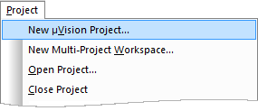
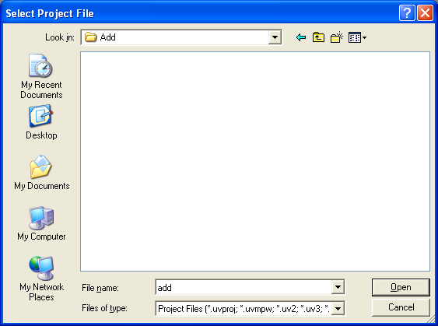
Step 2: Create your project
Select Project - New Project from the µVision4 menu. This opens a standard Windows dialog, which prompts you for the new project file name.
Create a new folder Add in your preferred destination directory.
Switch to the new folder and type the project name Add. µVision4 automatically adds the extension .uvproj.
Click Save.
Note: Use a separate folder for each project.

Slide 157
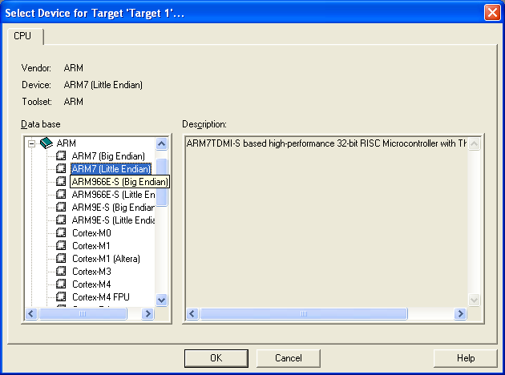
Step 3: Select Device
Select the microcontroller you use. For our tutorials, choose ARM > ARM 7 (Big Endian)

Slide 158
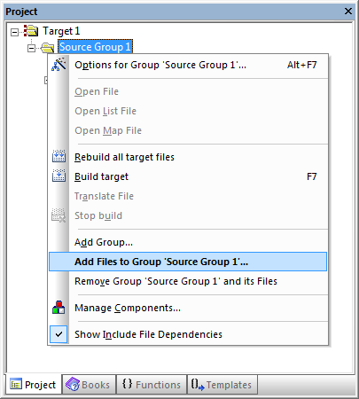
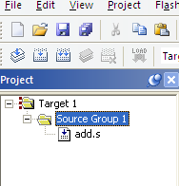
Step 4: Write your assembly code
Create your file: Go to File - New menu. This opens an empty editor window where you can enter your source code. µVision4 enables color syntax highlighting, when the file is saved with the extension *.S, *.C or *.CPP.
Save the file using File - Save As..., and name it, e.g. , add.s. The extension .s is an assembly code file.
Write the code in the text editor
Add the file to your project. Invoke the Context Menu of the Source Group 1 in the Project Window (shown in the left Figure)
The navigation panel should look like this

Slide 159
Step 5: Setting the environment
To run the program, your program needs to be loaded into the main memory.
Different locations may be assigned for the code and data area, depending on your setup.
In the simulation environment of uVision, this can be set.
In a physical environment, this is determined by the hardware setup.
Memory
Code AREA (PROGRAM)
LDR R1, A
LDR R2, B
ADD R1, R1, R2
STR R1, C
HERE BAL HERE
Data AREA (Data1)
A
0x0000000A
0x00000014
0x00000000
B
C

Slide 160
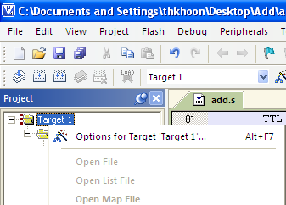
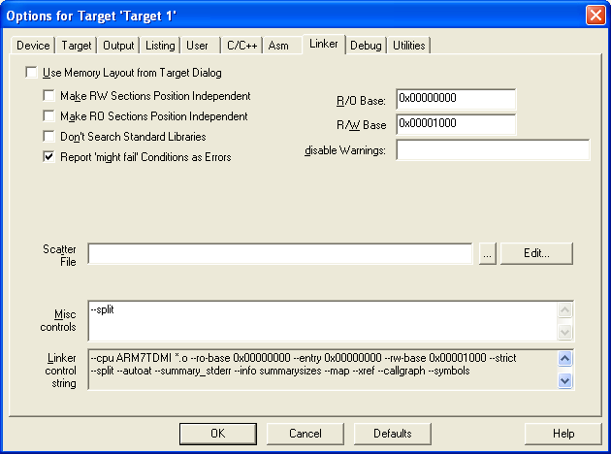
Step 5: Setting the environment
Right-click on Target 1 in the navigational panel and select ‘Options for target ‘Target 1’’
The options menu box will pop up. Goto Linker. For our classes, we shall follow the following setup for all our tutorials.
Use separate regions for the code and data.
Set R/O Base to 0x00000000 to define the code area
Set R/W Base to 0x00001000 to define the data area
Put an extra parameter --split at misc controls (double hyphen)
Source: http://www.keil.com/support/man/docs/armlink/armlink_Cacbdbbc.htm

Slide 161
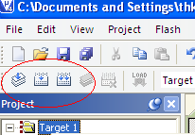
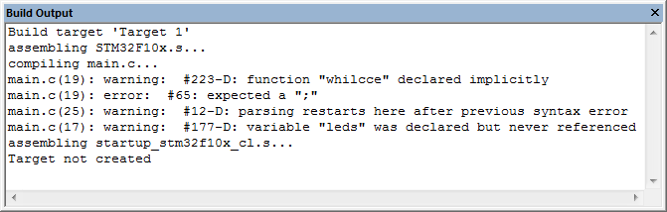
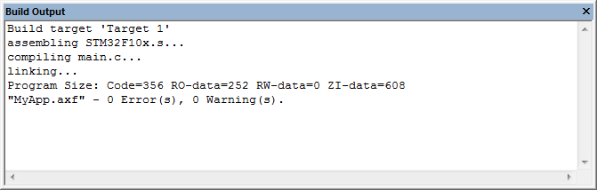
Step 6: Assembling your program
Assemble and link the source files of the application by clicking on one of the build-buttons located in the Build Toolbar.
If there are errors, they will be displayed in the Build Output Window. Double-click to jump to the error line. Correct the error and recompile.
With Error
Important: Remember to re-build your program after you make changes to your source code!!!
Without Error

Slide 162
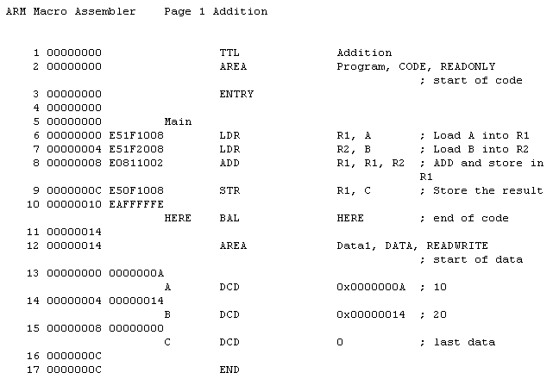
Debugging Using the .O and .LST File
After assembling your program, three important file will be created in your project directory:
.o file which stores the machine code/binary to be stored in the memory
.lst file is a file which shows the result of assembled machine code arranged line by line with your assembly code. This file is created for your debugging purposes only.
Memory Location
(not absolute)
Assembly Code
Machine
Code
The memory for both code and data is not absolute . They have to be added to a base address:
R/O base: 0x0000 0000
R/W base: 0x0000 1000

Slide 163
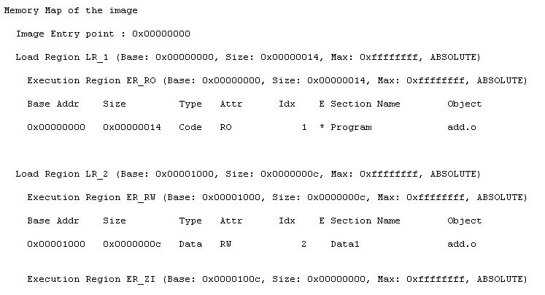
MAP File
After assembling your program, three important file will be created in your project directory:
.o file which stores the machine code/binary to be stored in the memory
.lst file is a file which shows the result of assembled machine code arranged line by line with your assembly code. This file is created for your debugging purposes only.
.map file which shows the absolute address of the code and data area.
- Memory map specifies where the code and data section is loaded in the memory

Slide 164
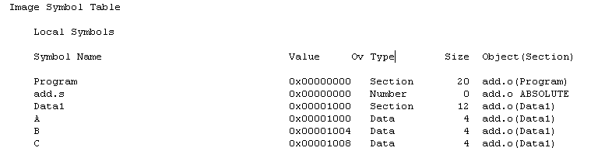
MAP File
After assembling your program, three important file will be created in your project directory:
.o file which stores the machine code/binary to be stored in the memory
.lst file is a file which shows the result of assembled machine code arranged line by line with your assembly code. This file is created for your debugging purposes only.
.map file which shows the absolute address of the code and data area.
- Memory map specifies where the code and data section is loaded in the memory
- Symbol table specifies the absolute address of each variable

Slide 165
Step 7: Running and Debugging
Debugging is one of the most important skill you need to acquire when writing programs. If you do not know how to debug your program, you have not really master programming.
The debugging windows allows you to do the following
Step through your program line-by-line. From here, we can check if the execution flow of your code is according to what you expect the program to do. If it doesn’t, you can pinpoint what is wrong with your code.
Monitor the values of the registers. From here, we can monitor if the register has been updated correctly.
Monitor the values of the specified memory. From here, we can monitor if the memory is being updated/loaded correctly.
Click Debug > Start/Stop Debug Session (or Ctrl-F5) to start debugging

Slide 166
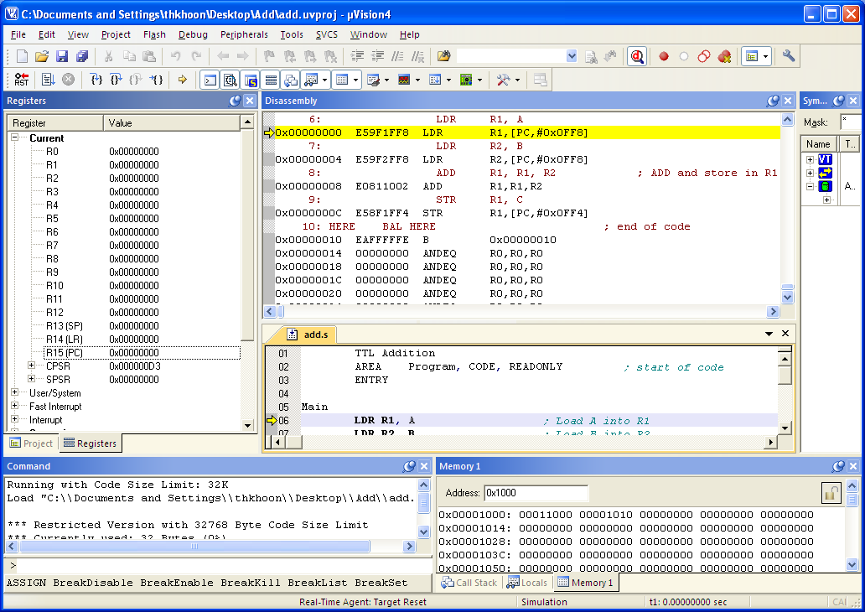
Step 7: Running and Debugging
Registers window shows you the value of the content of the registers during execution including the Program Counter or PC (R15) and the Status Register or CPSR.
Current value of PC = 0x0 (start of program)

Slide 167
Step 7: Running and Debugging
Code Window shows your assembly code. The yellow arrow shows the next instruction to be executed.

Slide 168
Step 7: Running and Debugging
Disassembly Windows shows the assembly code and its corresponding machine code and the relative (not absolute) address of each code.
The yellow arrow points to the next instruction to be executed which is corresponding to the Program Counter (PC) value shown in the Register Window.

Slide 169
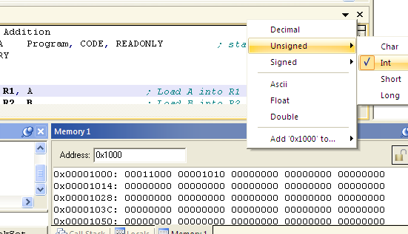
Step 7: Running and Debugging
Memory Windows shows the content of the memory at the specified location. Normally, we would like to view the content as unsigned integer. To change the settings for the view mode,
Right click on the bar on the right of the address, and select Unsigned > Int
Make sure the Decimal option is NOT checked.

Slide 170
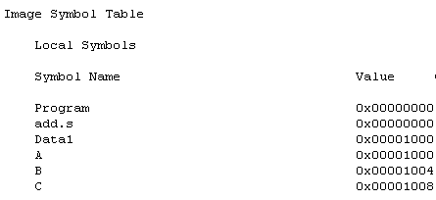
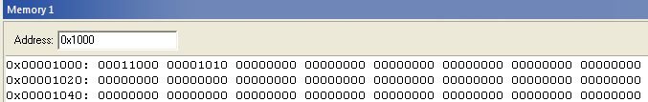
Step 7: Running and Debugging
Memory Windows
Type the address you are interested to observe its content
Assembly code (.s)
From the map file (.map):
…
AREA Data1, DATA, READWRITE ; start of data
A DCD 0x0000 000A DCD 0x0000 0014
C DCD 0
Memory content:

Slide 171
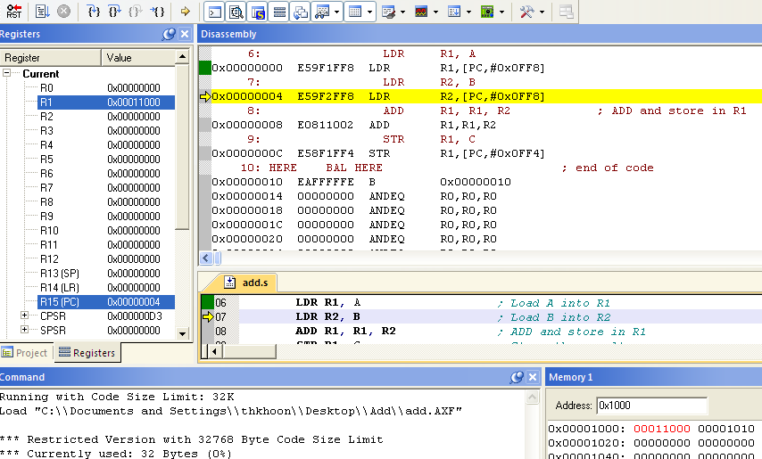
Step 7: Running and Debugging
To run an instruction, press F10 or press the Step-Into/Step-Through Button. Yellow line indicates next instruction to run.
Instruction #1: LDR R1, A
R1 is updated with the value pointed by A
R1 ← [A] where A = 0x00001000 and [A] = 0xA
PC ← PC + 4 = 0x4 (points to the next instruction)

Slide 172
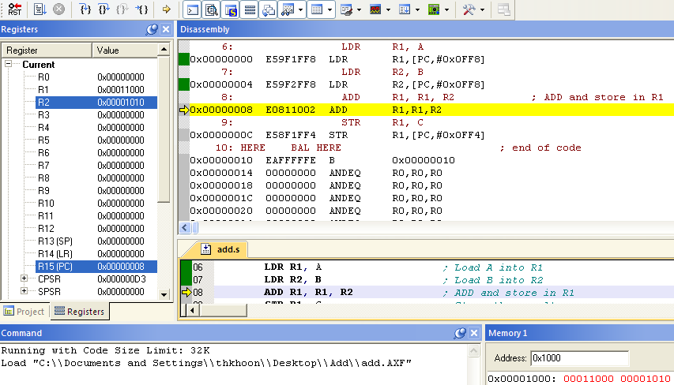

Step 7: Running and Debugging
To run an instruction, press F10 or press the Step-Into/Step-Through Button
Instruction #2: LDR R2, B
R2 is updated with the value pointed by B
R2 ← [B] where B=0x00001004 and [B] = 0x14
PC ← PC + 4 = 0x8

Slide 173
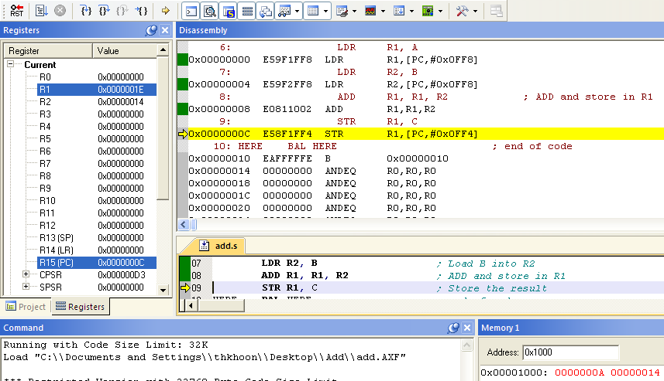
Step 7: Running and Debugging
To run an instruction, press F10 or press the Step-Into/Step-Through Button
Instruction #3: ADD R1, R1, R2
R1 ← R1 + R2 (10 + 20) = 30
PC ← PC + 4 = 0xC

Slide 174
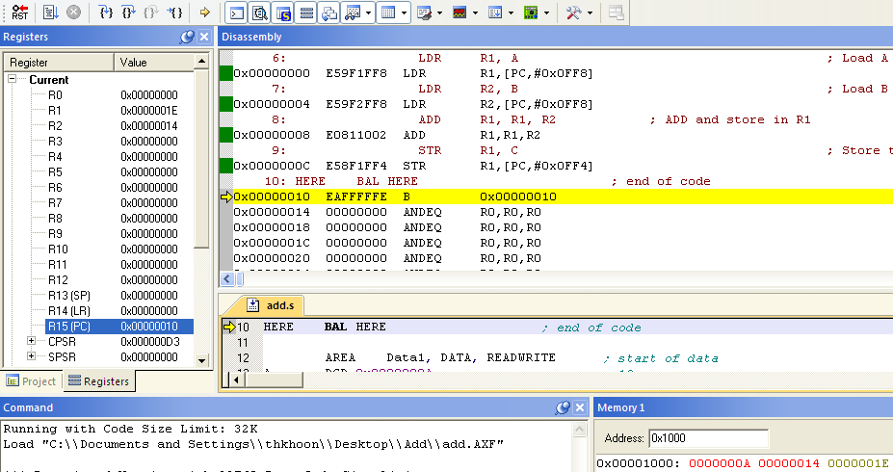
Step 7: Running and Debugging
To run an instruction, press F10 or press the Step-Into/Step-Through Button
Instruction #3: ADD R1, R1, R2
R1 ← R1 + R2 (10 + 20 = 30
PC ← PC + 4 = 0xC
Instruction #4: STR R1, C
[C] ← R1
PC ← PC + 4 = 0x10

